Slide 1
A Network Approach to Modeling Comorbid Internalizing and Alcohol Use Disorders
J.J. Anker, P. Thuras, J. Menk,
B.L. Wagner, Z.W. Almquist, A. Unruh, M.K. Forbes, J. Simundson,
M.G. Kushner
University of Minnesota, Departments of Psychiatry, Minneapolis MN, 55454, United States

Slide 2
Conflicts of Interest Statement
I, or an immediate family member, including a spouse or partner, have no financial relationships or any other relationship which could reasonably be considered a conflict of interest relevant to the content of this CE activity.

Slide 3
Objective 1: Visualize the network structure of the Vicious Cycle Model of comorbid internalizing (INT) and alcohol use disorder (AUD).
Objective 2: Probe the contribution of specific elements to network connectivity to identify high value treatment targets.

Slide 4
Problem and Background

Slide 5
Comorbidity is highly prevalent among AUD patients
Among AUD patients, rates of anxiety and depression disorders range between
25% to 50%
AUD
INT
(Kushner, Krueger, Frye, & Peterson, 2008; Kushner et al., 2012)

Slide 6
Comorbidity interferes with AUD treatment
Among AUD patients, rates of anxiety and depression disorders range between
25% to 50%
AUD
INT
Dependence severity
Withdrawal severity
Persistence of AUD
x2 Relapse Risk
(Cornelius et al., 1997; Greenfield et al., 1998; Haver, 2003; Helzer & Pryzbeck, 1988; Kushner et al., 2005; Regier et al., 1990; Tómasson & Vaglum, 1995)

Slide 7
Treatment of INT does not improve AUD outcomes among comorbid individuals
(meta-analysis by Hobbs et al., 2011)
AUD
COMORBIDITY
INT
x2 Relapse Risk

Slide 8
This suggests conditions beyond INT maintain comorbidity and increase risk for AUD relapse
AUD
COMORBIDITY
INT
x2 Relapse Risk

Slide 9
DTC increases risk for AUD by a factor of 5 among those with an anxiety disorder
6
5
4
3
2
1
Drinking to Cope
NO Drinking to Cope
Menary, Kushner, Maurer, Thuras (2011). The prevalence and clinical implications of self-medication among individuals with anxiety disorders, JAD, 25, 335-339

Slide 10
Models of Comorbidity

Slide 11
Comorbidity develops through negatively reinforced drinking i.e., self-medication of INT symptoms → AUD
DTC
Self-Medication
(AUD ← INT)
AUD
INT

Slide 12
Drinking leads to stress-related neurobio adaptations and negative psychosocial consequences → INT
DTC
Self-Medication
(AUD ← INT)
AUD
INT
Consequences of Drinking
(AUD → INT)
AUD
INT
Stress

Slide 13
Combined, these processes form the Vicious Cycle Model of comorbidity
DTC
AUD
INT
Stress
Stress

Slide 14
The Vicious Cycle provides an explanation of why treatment of INT does not improve AUD outcomes
DTC
AUD
INT
Stress

Slide 15
INT treatment alone fails to address DTC, which remains available to maintain or re-initiate the Vicious Cycle
DTC
AUD
INT
Stress

Slide 16
Study Objectives
Objective 1: Use network analysis to visualize the structure of unique relationships between elements of the vicious cycle model.
DTC
AUD
Comorbidity
INT
Stress
Objective 2: Characterize changes in network structure when controlling for specific elements.
Identify central elements, that, if removed, would maximally disrupt relationships among other elements in the network.

Slide 17
General Methods

Slide 18
Sample
363 AUD Residential inpatients with a comorbid anxiety disorder
Assessed at the beginning of residential AUD treatment
AUD
INT

Slide 19
Sample
363 AUD Residential inpatients with a comorbid anxiety disorder
Assessed at the beginning of residential AUD treatment
Level of Analysis
Most NA studies in psychopathology define network elements at the symptom level
A smaller number define elements at the symptom/behavioral aggregate level
We adopt the former to align with the theoretical conceptualization of the vicious cycle
AUD
INT

Slide 20
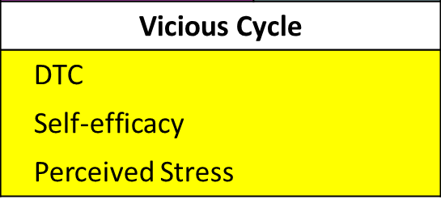
Sample
363 AUD Residential inpatients with a comorbid anxiety disorder
Assessed at the beginning of residential AUD treatment
Level of Analysis
Most NA studies in psychopathology define network elements at the symptom level
A smaller number define elements at the symptom/behavioral aggregate level
We adopt the former to align with the theoretical conceptualization of the vicious cycle
Measures
Network elements operationalized as summary scores representing levels of the following constructs:
Depr
DTC
Gen
Anx
Crave
Self
E
AUD
INT
Drink
Social
Agor
Stress
Panic

Slide 21
Objective 1: Visualizing the Network Structure of the Vicious Cycle

Slide 22
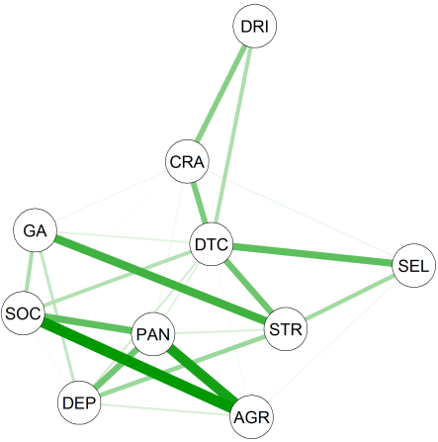
Using GLASSO to visualize the structure of unique relationships within the Vicious Cycle
GLASSO Network
*Lines/edges represents the relationship between two elements while controlling for all other elements

Slide 23
DTC and stress served as bridging elements between internalizing and alcohol elements
GLASSO Network
Element Legend
Alcohol
CRA | Craving
DRI | Total Drinks
Internalizing - Distress
GA | Gen Anxiety
DEP | Depression
Internalizing - Distress
SOC | Social Anxiety
PAN | Panic
AGR | Agoraphobia
Vicious Cycle
DTC | Drinking to Cope
SEL | Self-efficacy
STR | Perceived Stress
DRI
CRA
GA
DTC
SEL
SOC
PAN
STR
DEP
AGR
*Lines/edges represents the relationship between two elements while controlling for all other elements

Slide 24
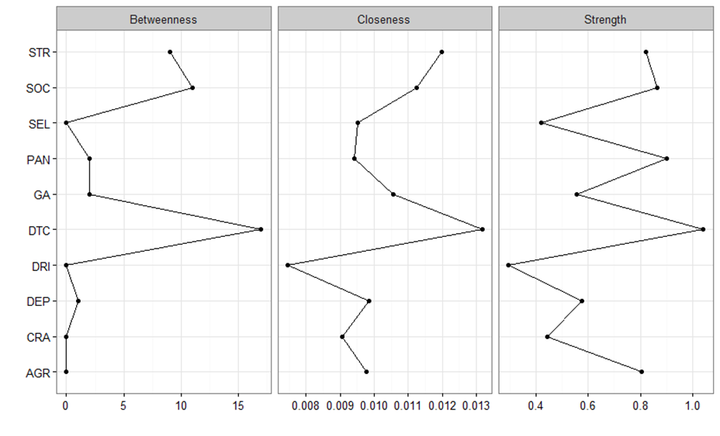
DTC was the most central element in the GLASSO network
GLASSO Network
Centrality Plot results for DTC
Betweenness
Closeness
Strength
DRI
CRA
DTC
GA
DTC
SEL
SOC
PAN
STR
Betweenness: lies on the shortest path between other elements
Strength: has the highest sum of connected edge weights
Closeness: has the highest # of actual (vs. possible) connections
DEP
AGR
*Lines/edges represents the relationship between two elements while controlling for all other elements

Slide 25
Objective 2: Models Probing the Contribution of Specific Elements to Network Connectivity

Slide 26
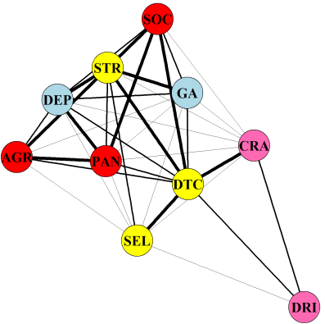
A zero-order correlation matrix was plotted using the Fruchterman and Reingold algorithm
Baseline/Association Network
Element Legend
Alcohol
CRA | Craving
DRI | Total Drinks
Internalizing - Distress
GA | Gen Anxiety
DEP | Depression
Internalizing - Distress
SOC | Social Anxiety
PAN | Panic
AGR | Agoraphobia
Vicious Cycle
DTC | Drinking to Cope
SEL | Self-efficacy
STR | Perceived Stress
SOC
We computed a series of semi-partial correlations that systematically controlled the variance associated with selected individual elements in the model.
STR
DEP
GA
AGR
CRA
PAN
DTC
SEL
DRI

Slide 27
After controlling for DTC the alcohol elements became isolated.
Baseline/Association Network
DTC Probe
SOC
DRI
CRA
STR
DEP
GA
AGR
CRA
PAN
DTC
GA
SEL
AGR
SEL
DEP
STR
DRI
SOC
PAN

Slide 28
Baseline/Association Network
DTC Probe
SOC
DRI
CRA
STR
DEP
GA
AGR
CRA
PAN
DTC
GA
SEL
AGR
SEL
DEP
STR
DRI
SOC
PAN

Slide 29
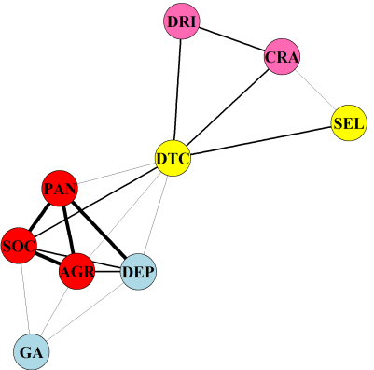
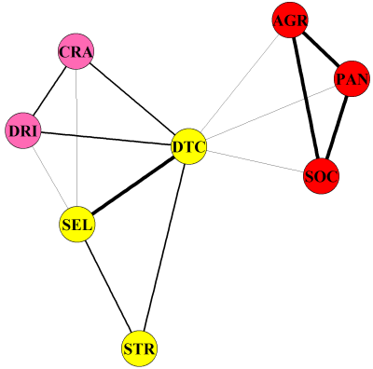
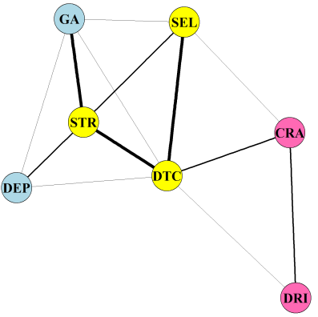
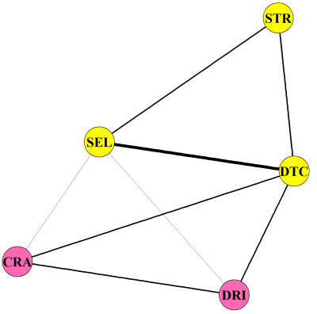
This level of change was unique to the influence of DTC
Stress Probe
Distress Probe
DRI
AGR
DTC Probe
CRA
CRA
PAN
SEL
DRI
DTC
DTC
DRI
PAN
SOC
CRA
SOC
SEL
AGR
DEP
GA
STR
Fear Probe
Internalizing Probe
GA
SEL
STR
GA
AGR
SEL
STR
CRA
DEP
STR
SEL
DEP
DTC
DTC
SOC
PAN
CRA
DRI
DRI

Slide 30
This study characterized relationships between elements of the Vicious Cycle Model using network analysis.
Summary of findings:
DTC served as a bridge between internalizing and alcohol elements.
Centrality indices indicated that DTC ranked as the most central element in maintaining network coherence.
After controlling for DTC, alcohol elements became isolated from the other network elements.
This level of change was unique to the influence of DTC and did not occur after other elements were controlled.
Conclusion:
These findings inform clinical hypotheses for interventions targeting DTC to eliminate the connection between comorbid internalizing and alcohol use disorders.

Slide 31
Acknowledgements
Federal Grant Support
NIAAA: R01 AA015069
Awarded to Matt. G. Kushner
NIDA: T320A037183
To support the work of the Justin J. Anker and Miri K. Forbes
Mentor Support
Matt G. Kushner
John Grabowski
Marilyn E. Carroll
Data collection
Joani Van Demark
Eric W. Maurer
Chris Donahue
Brenda Frye
Kyle R. Menary
Jennifer Hobbs
Angela M. Haeny

Slide 32
Extra Slides

Slide 33
Study Sample
the average age was 39.3 (standard deviation [SD] = 10.24)
38% were female (N = 138).
Patients with more than one of the three anxiety disorders required for inclusion in the study were asked to identify their “primary” disorder in terms of its interference in their daily functioning:
41.7% endorsed primary social anxiety disorder (N = 151)
40.3% endorsed primary generalized anxiety disorder (N = 146)
14.9% endorsed primary panic disorder without agoraphobia (N = 54)
3.0% endorsing primary panic disorder with agoraphobia (N = 11)
two or more co-occurring anxiety disorders (56.0%, N = 201)
met diagnostic criteria for major depression (51.4%, N = 186).

Slide 34
Study Assessments
Internalizing Distress Measures (Blue)
Generalized Anxiety (GA) | Penn State Worry Questionnaire | 64.13 (11.59)
Depression (DEP) | Beck Depression Inventory | 20.40 (9.09)
Internalizing Fear Measures (Red)
Social Phobia (SOC) | Social Phobia Scale | 32.43 (17.30)
Panic Disorder (PAN) | Panic Disorder Severity Scale | 10.99 (6.34)
Agoraphobia (AGR) | Mobility Inventory for Agoraphobia | 31.59 (19.78)
Alcohol-Related Measures (Pink)
Alcohol Craving (CRA) | Obsessive Compulsive Drinking Scale | 2.67 (1.05)
Total Drinks 4 Months Before Treatment (DRI) | Time Line Follow-Back Interview | 1608.76 (1271.51)
Stress and Coping Measures (Yellow)
Perceived Stress (STR) | Perceived Stress Scale | 28.15 (5.50)
Drinking to Cope with Negative Affect (DTC) | Inventory of Drinking Situations – Unpleasant Emotions Subscale | 62.93 (12.15)
Coping Self-Efficacy (SEL) | Situational Confidence Questionnaire – Negative Emotions Subscale | 32.91 (10.91)

